Slide 1

G O W A Goa Overwhelmingly Welcome Arrivals -Team Exponential 2.0

Slide 2

Team Exponential2.0 -NIT PATNA
DR-135 Virtual Tourist Guide
-Government of GOA
TEAM Members: Archna Bharti [C]
AMAN Raj sundram
Ravikant Singh
priyanshu NayaN
Atul Kumar
Shikhar Srivastava

Slide 3
Problem Statement
Goa is a major tourist destination which pulls thousands of tourists every year. Goa is known for its beautiful beaches and hospitality. There are a number of monuments and landmarks depicting the cultural, history and development of Goa. Due to high inflow of domestic as well as international tourists, the manpower required to guide the tourist on these landmark is not sufficient and sometimes lack in the information that need to be given and highlighted to the tourist. Hence we propose the problem of developing a mobile application which renders information about the monument or landmark just by taking their live pictures as inputs. In other word, the application should allow the user to click a photograph and based on the picture it should display information about the monument/landmark. The application should also notify the user about such monuments/landmarks in the vicinity. The app should also allow the user to give their inputs about the object and also add to knowledge creation about the monuments/landmark. The app should also be able to keep statics about the number of users referring to the monument/landmark along with details of the users.

Slide 4
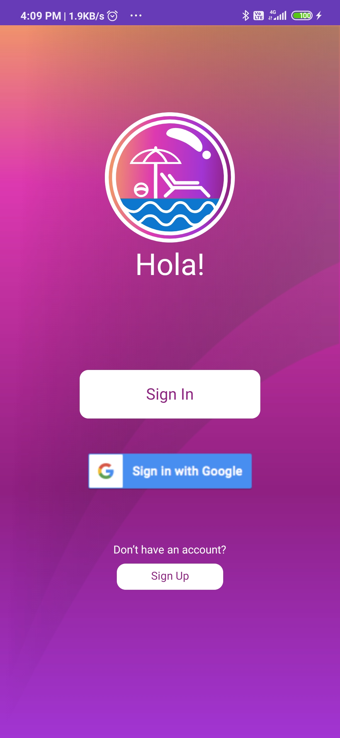
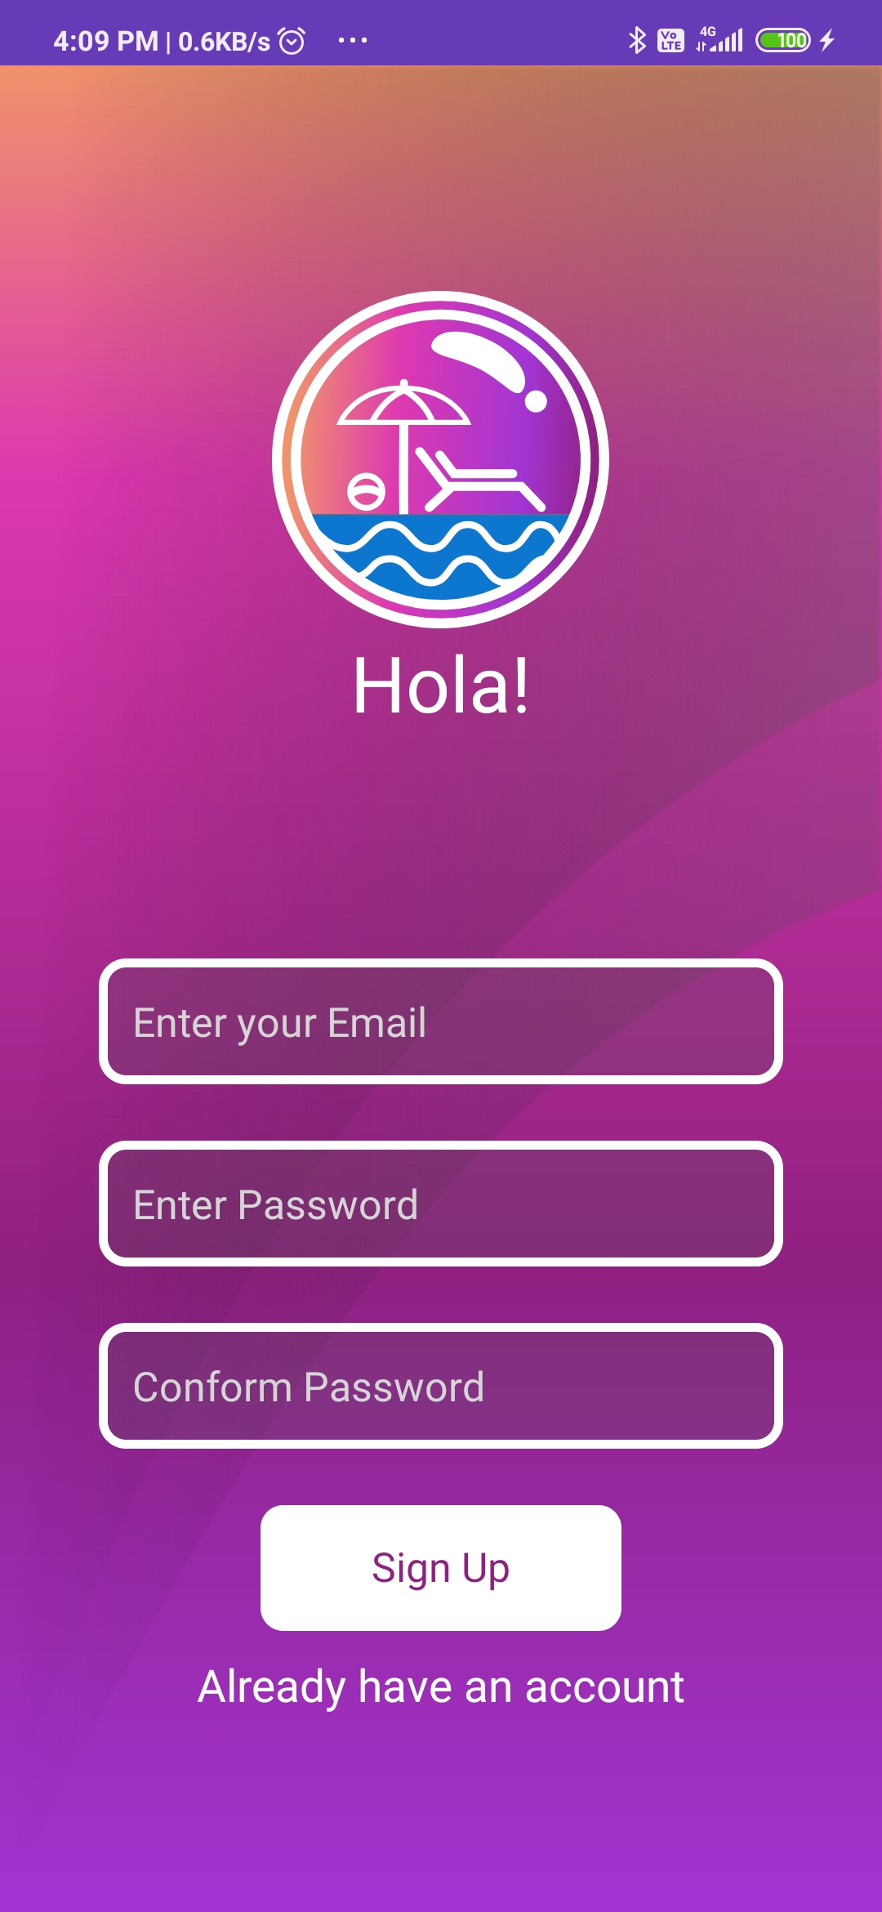
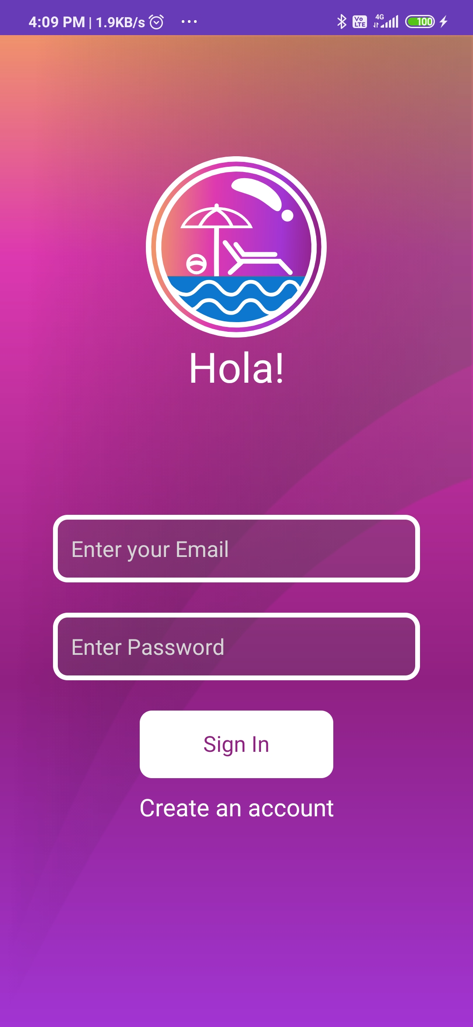

Slide 5
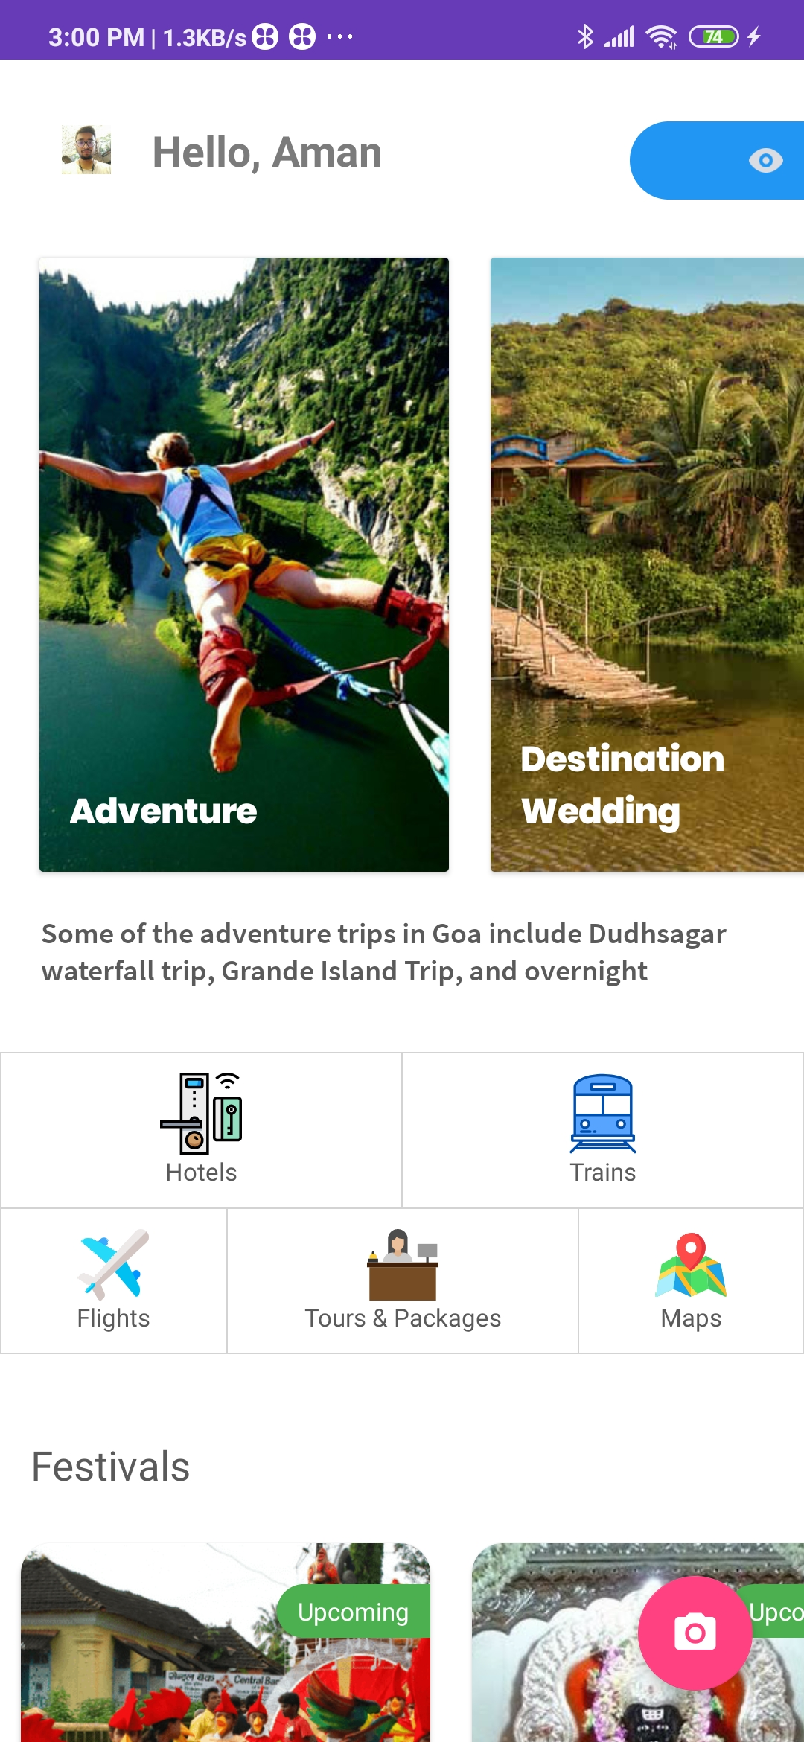
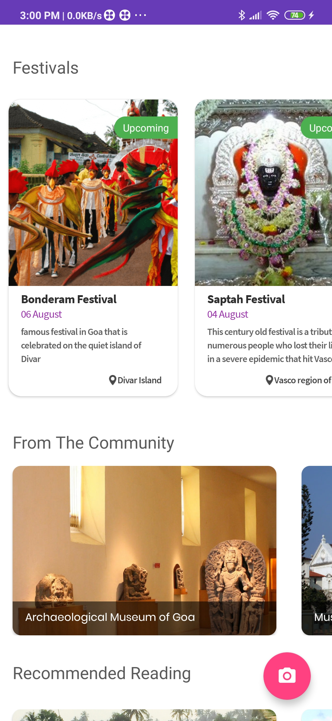
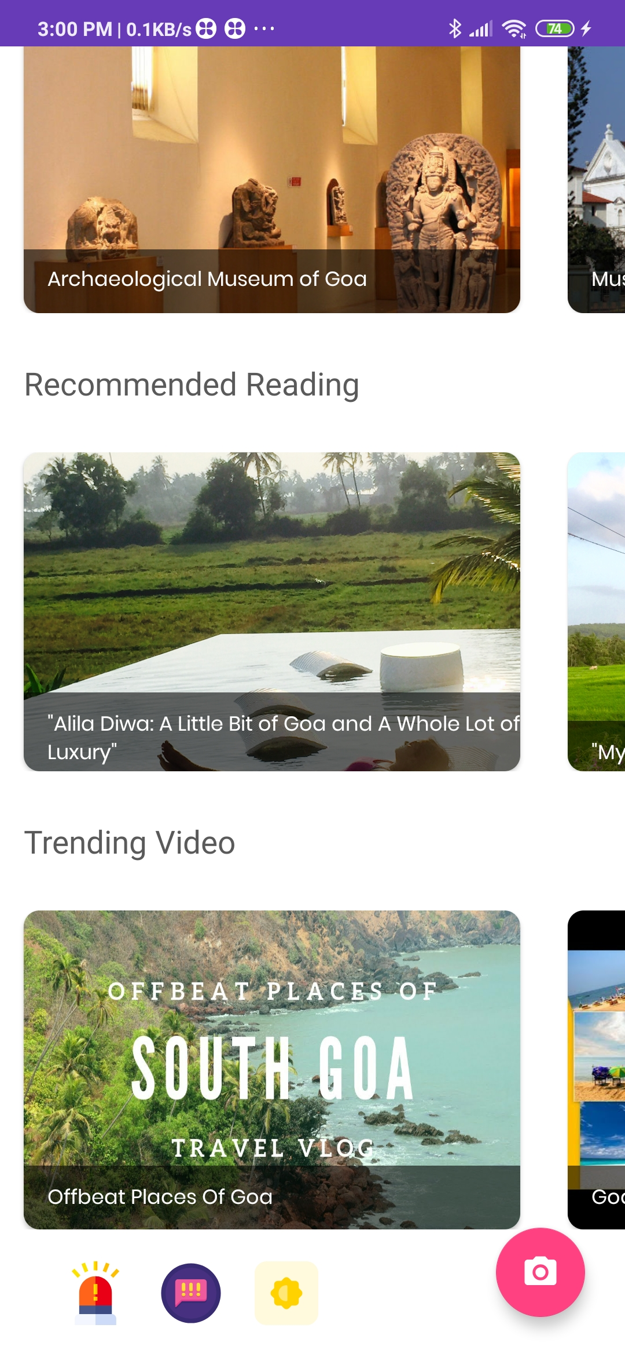
Personalized Home Screen, with iconified UI for ease of access. *SOS *Complaints *Dark Mode

Slide 6
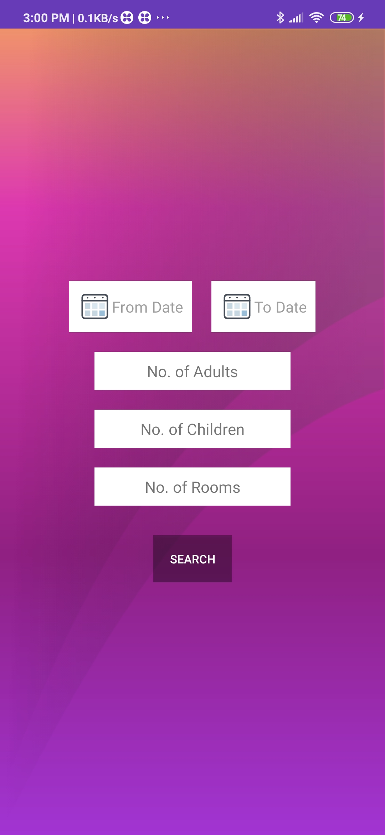
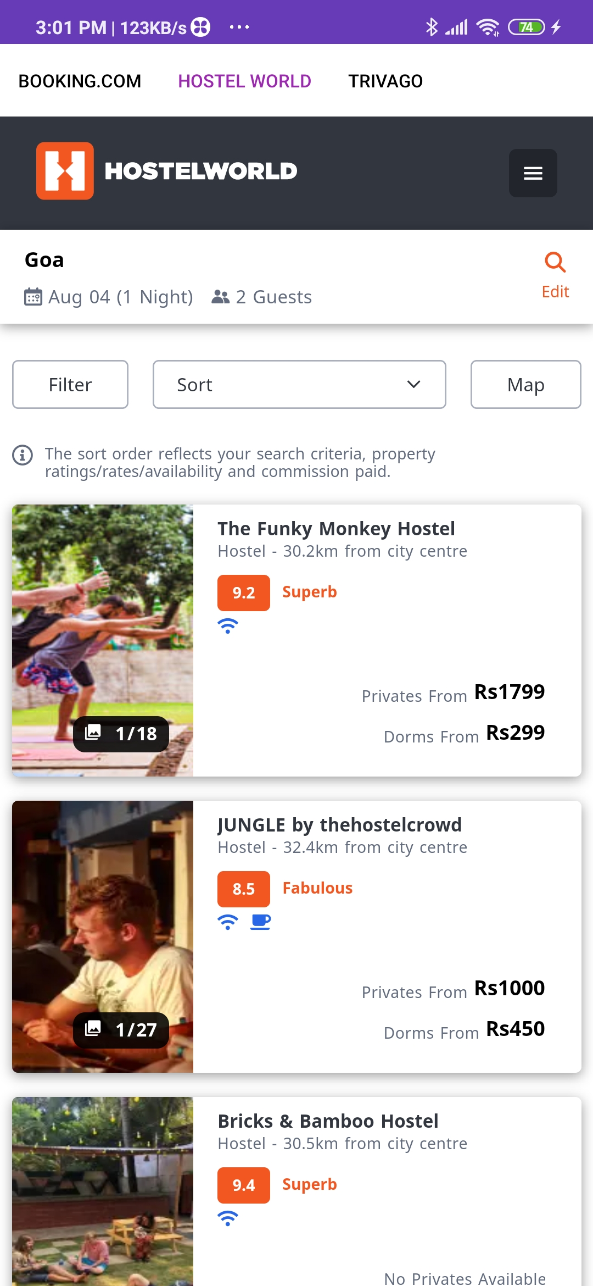
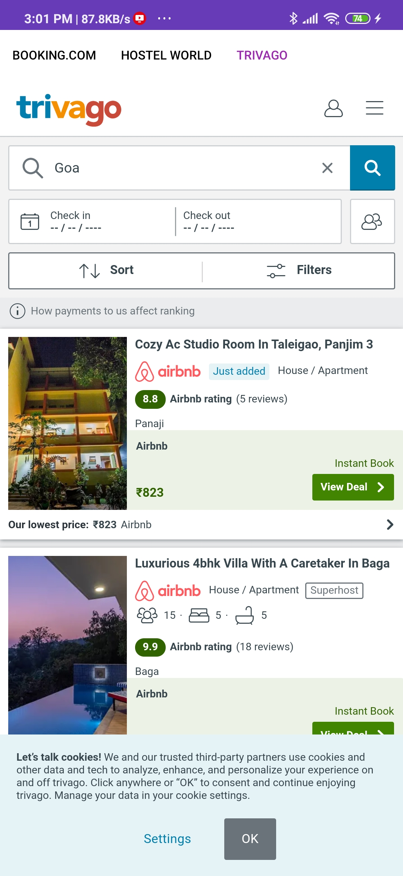
View Hotel options and compare to see what suits you best

Slide 7
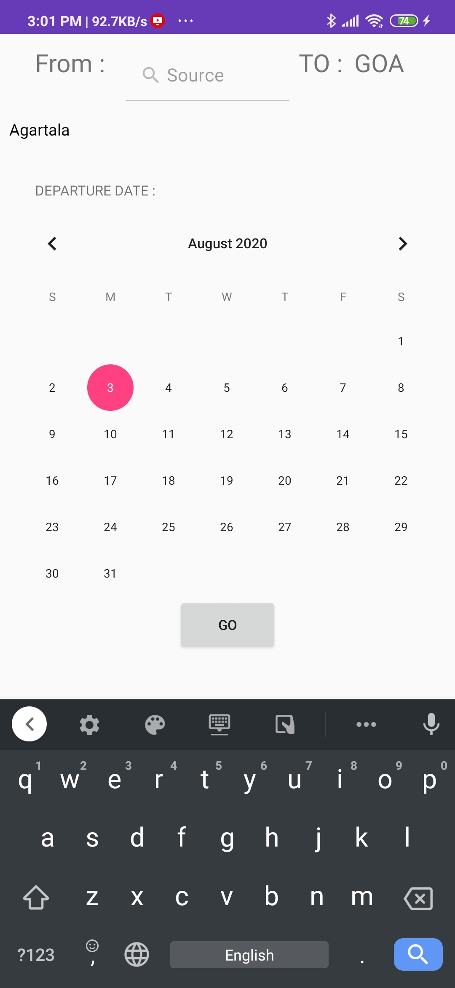
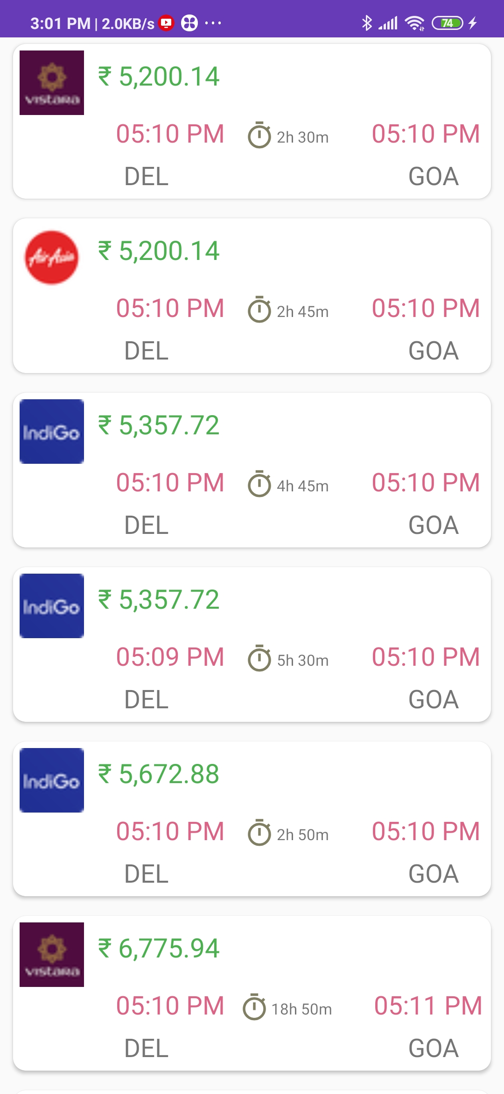
Flights and Trains booking on the go!

Slide 8
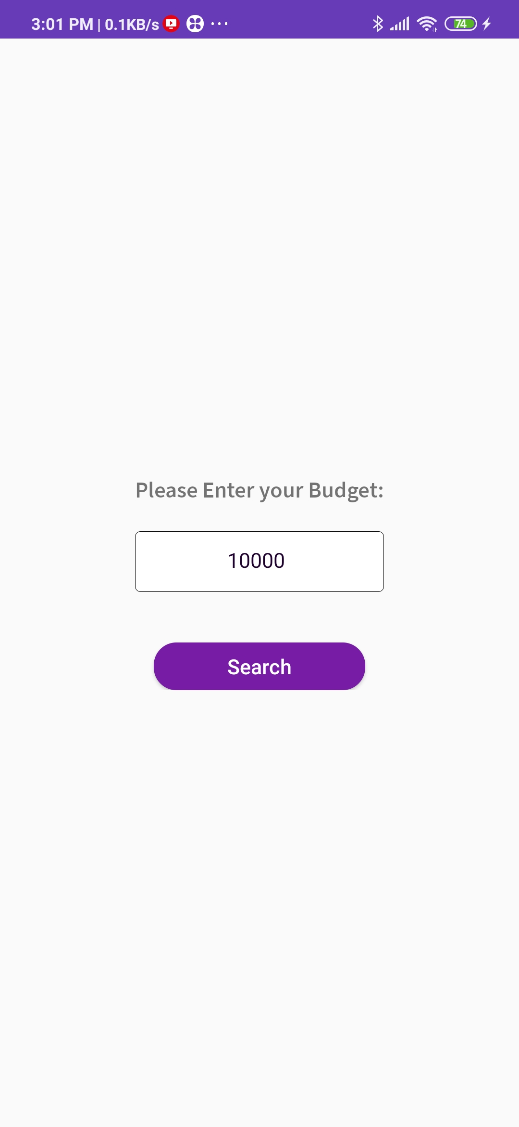
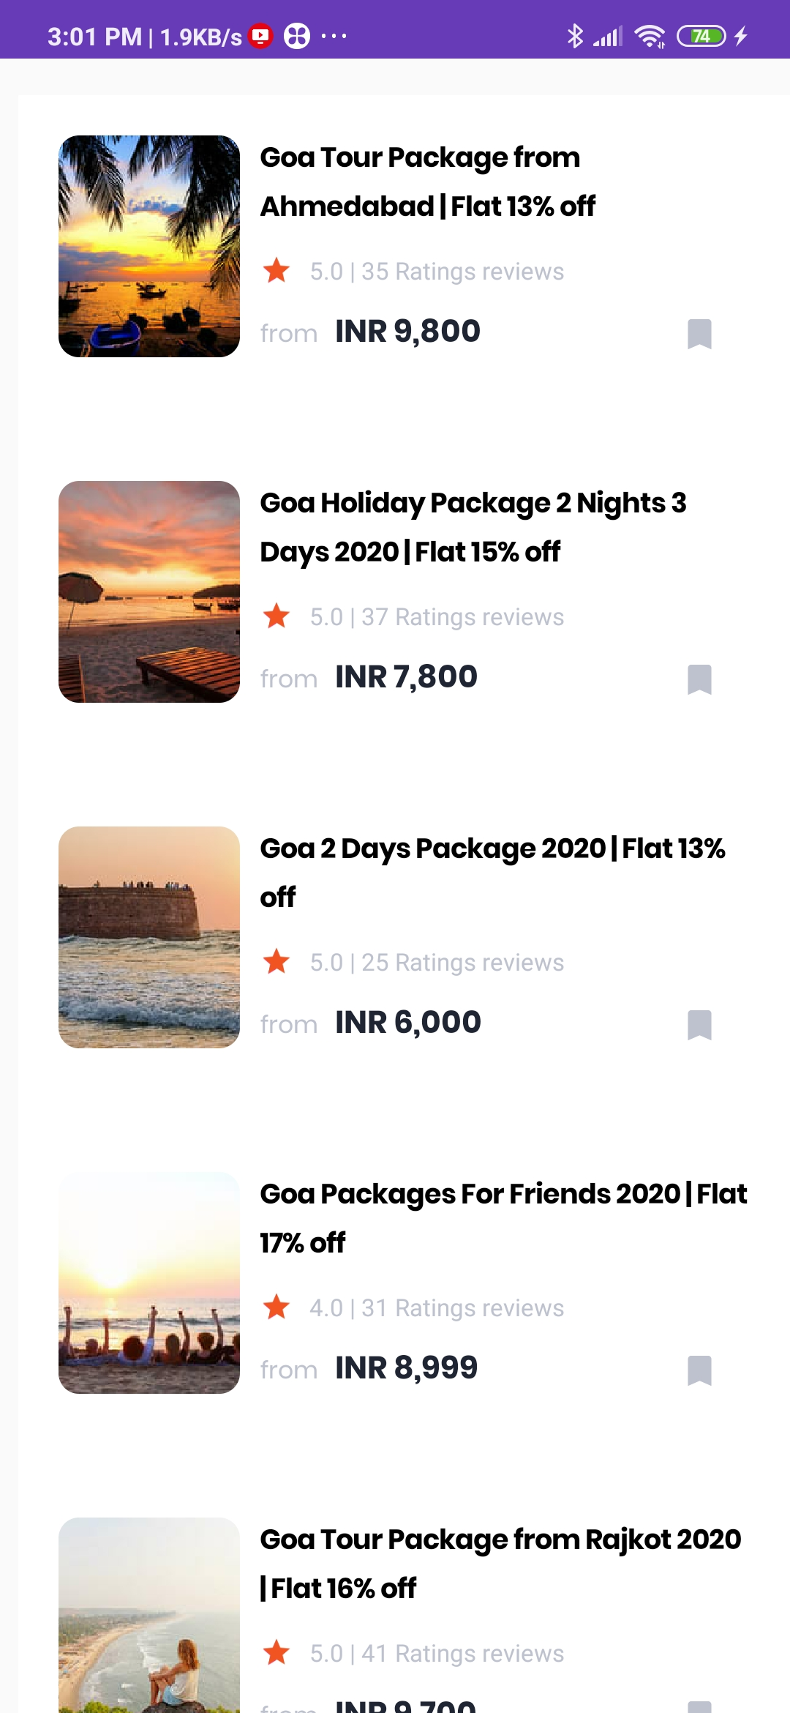
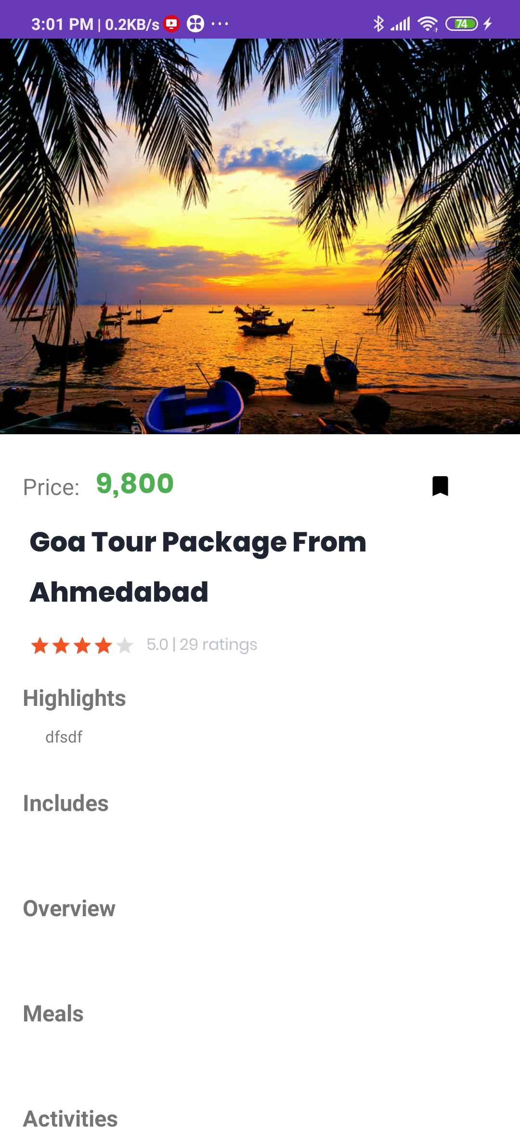
Find best according to your budget

Slide 9
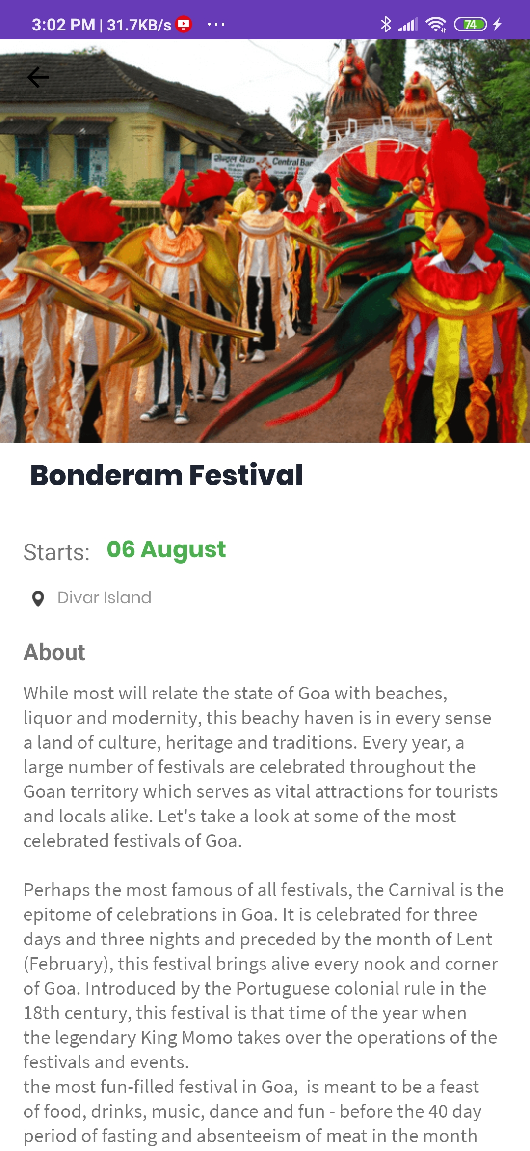
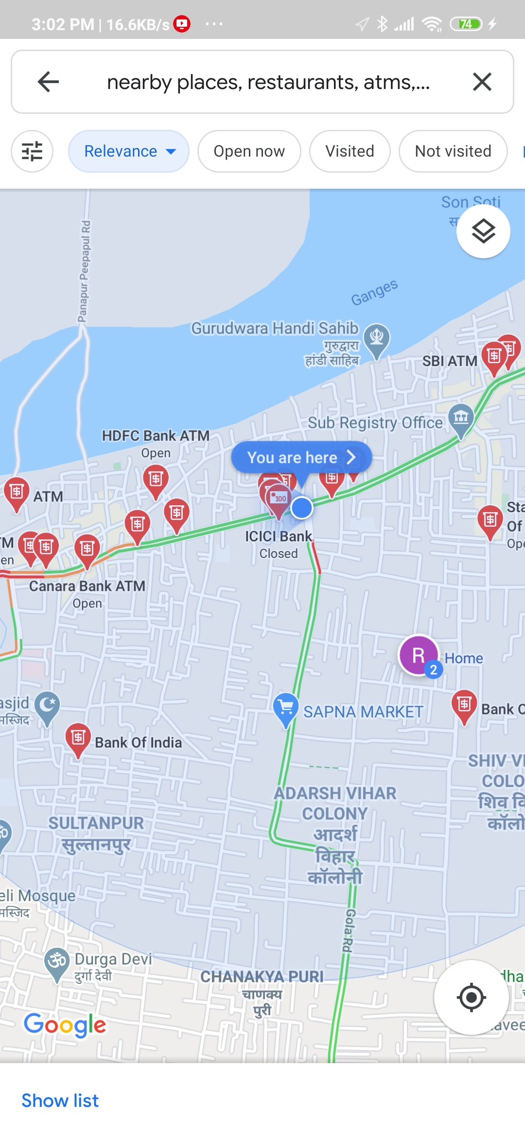
Information about Local Festivals and Nearby Places which may come handy for users

Slide 10
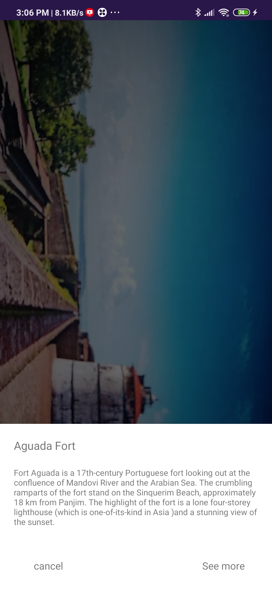
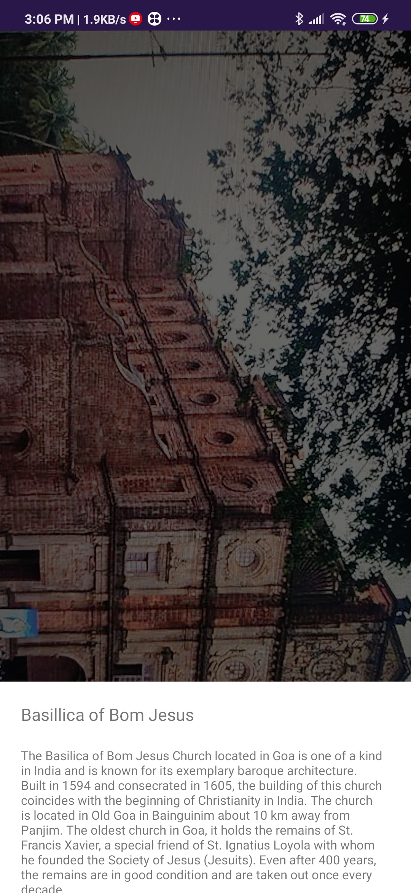
Scan the Monuments to get info about the history culture and heritage

Slide 11
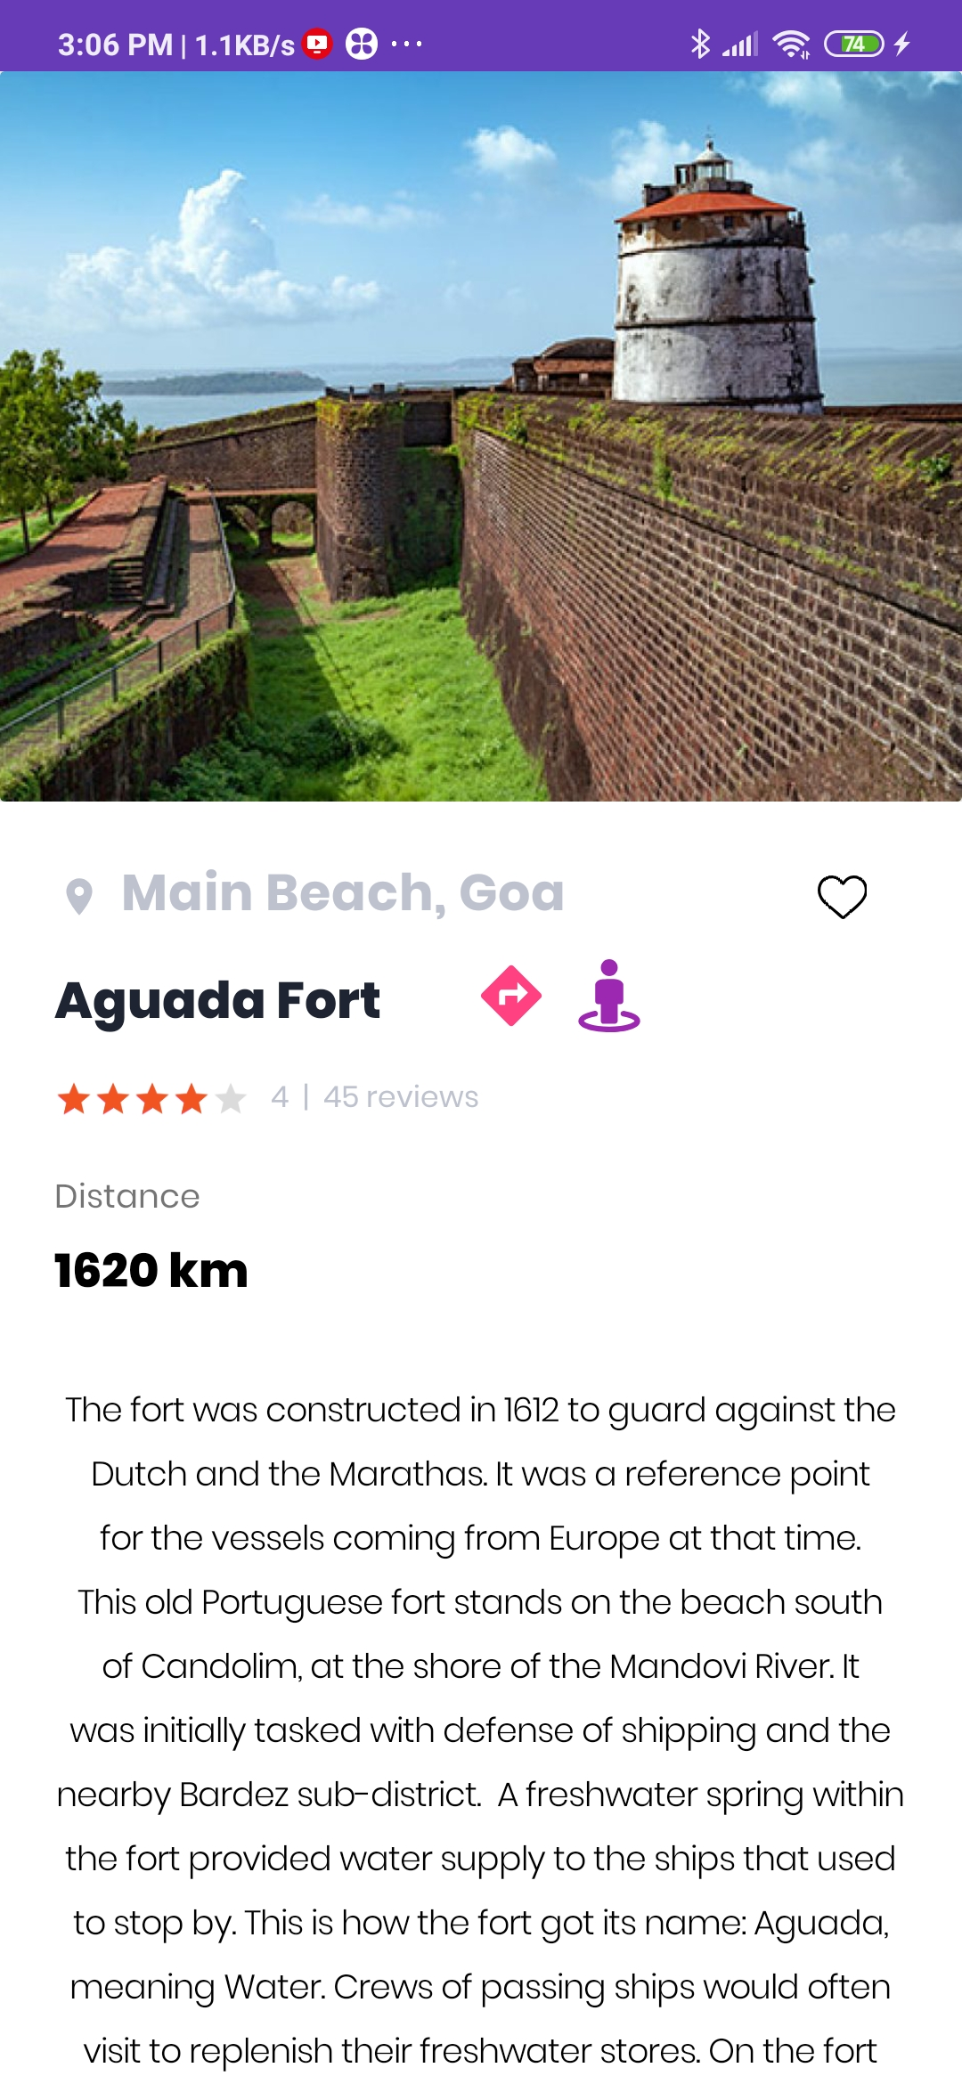
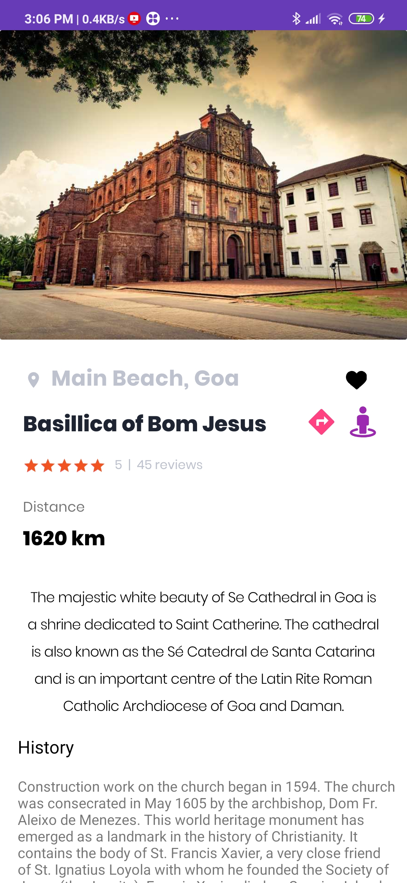
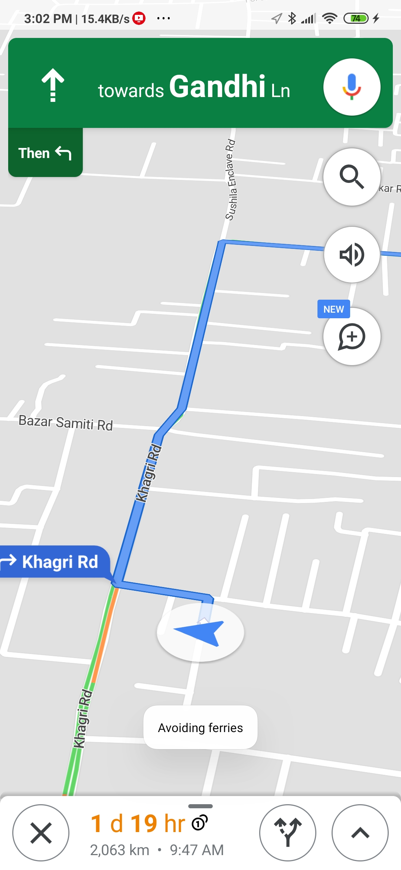
Not only see but also hear, locate on the map, get directions and much more

Slide 12
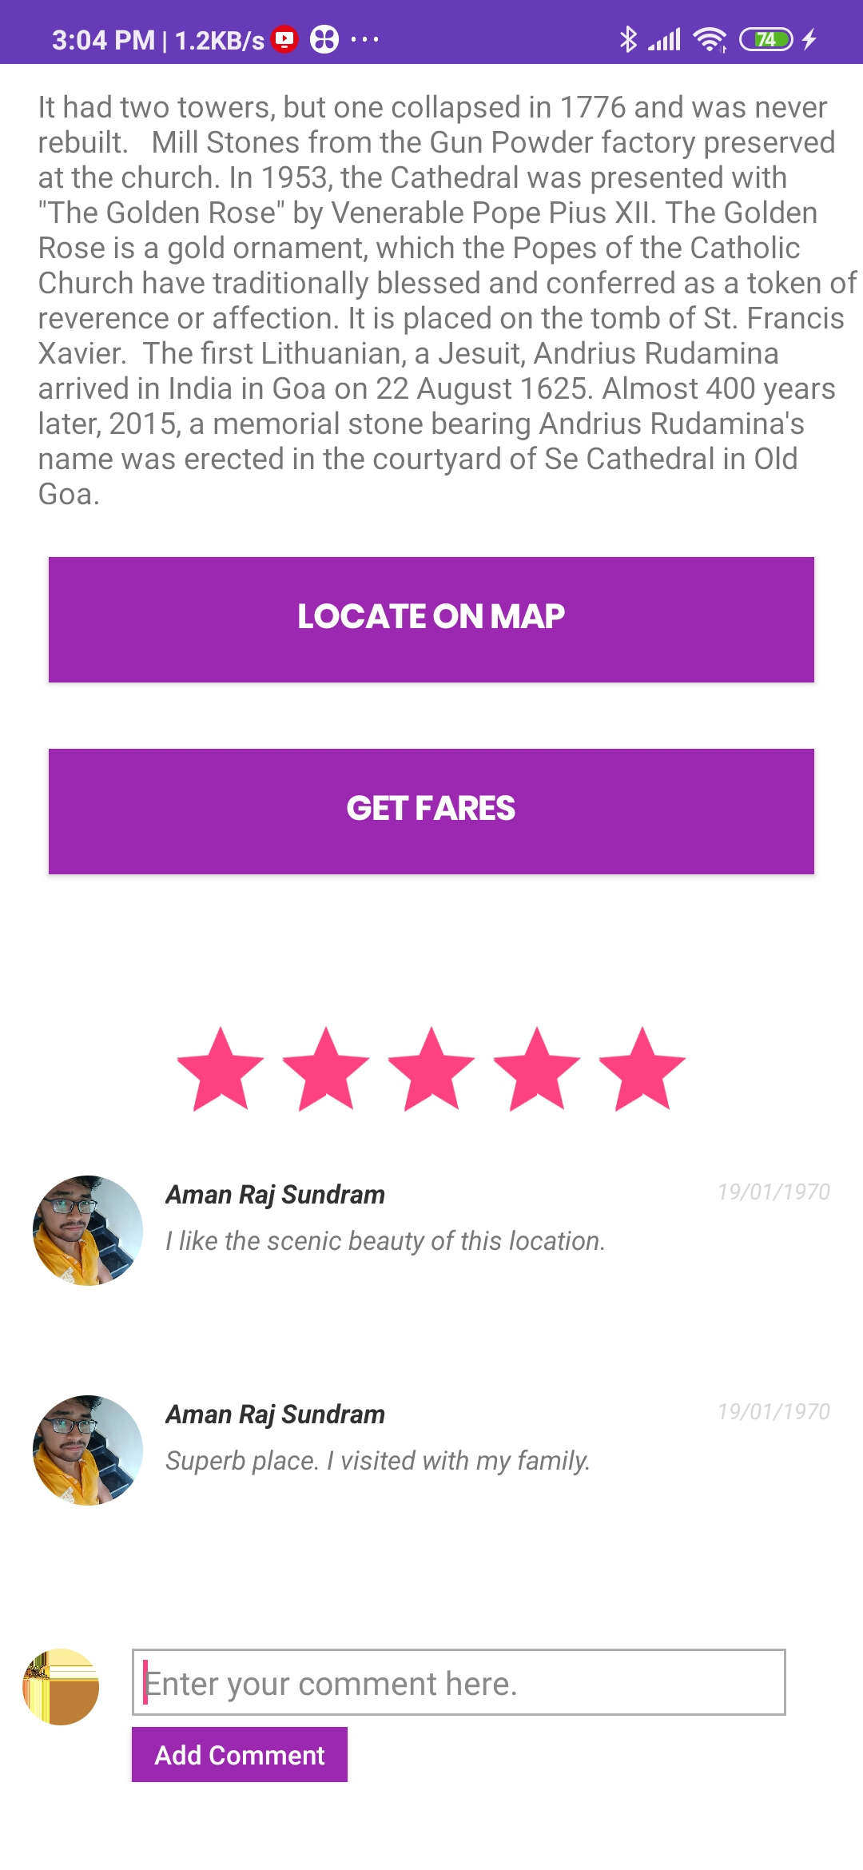
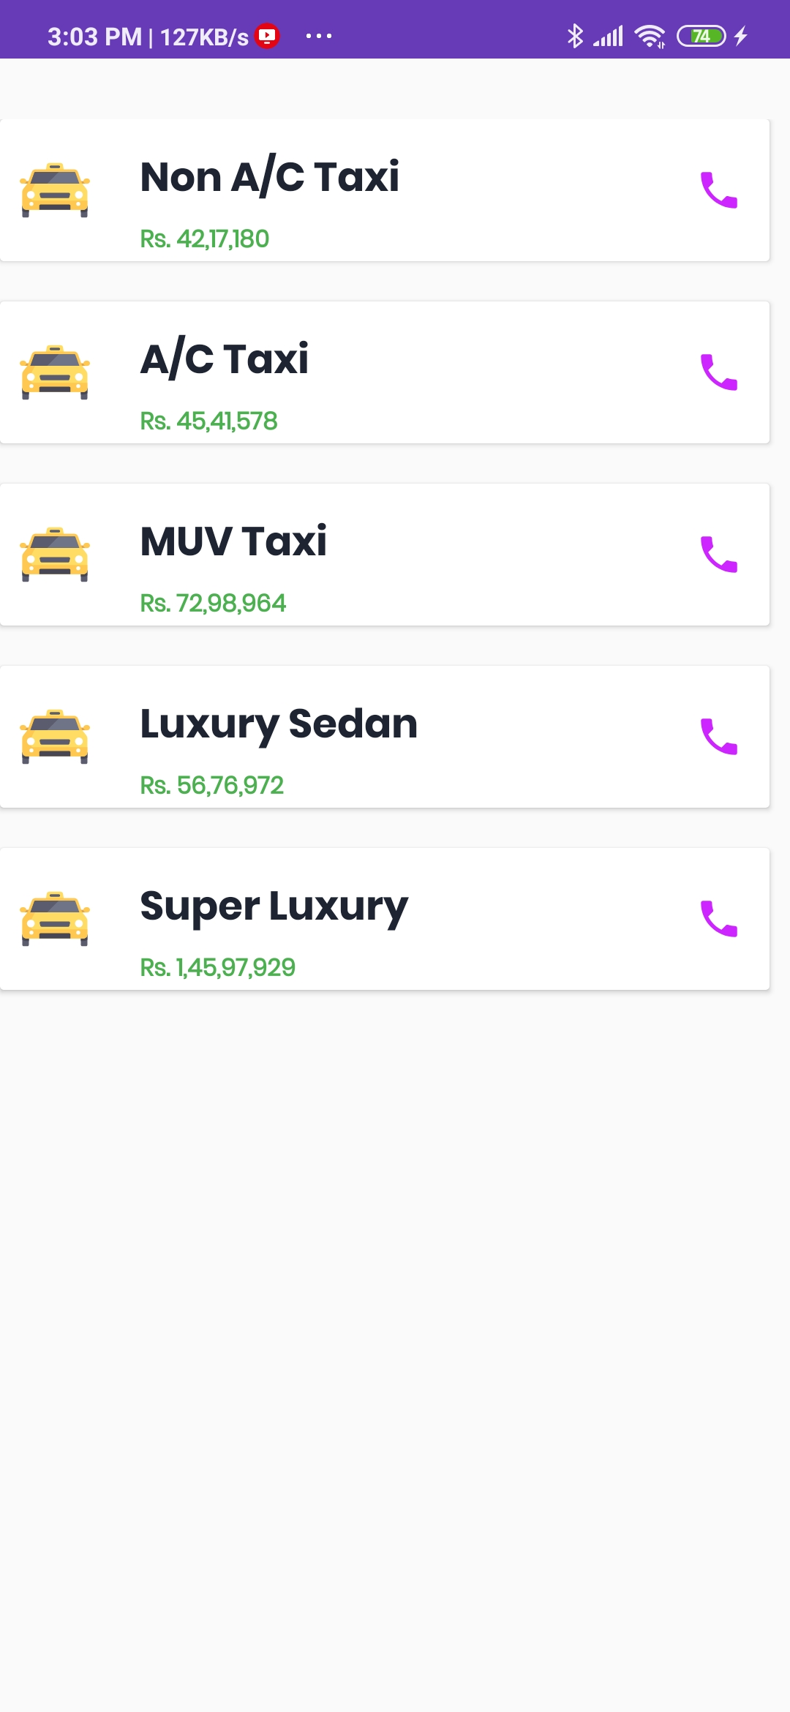
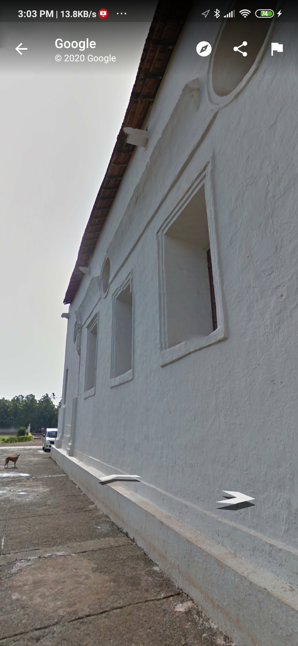
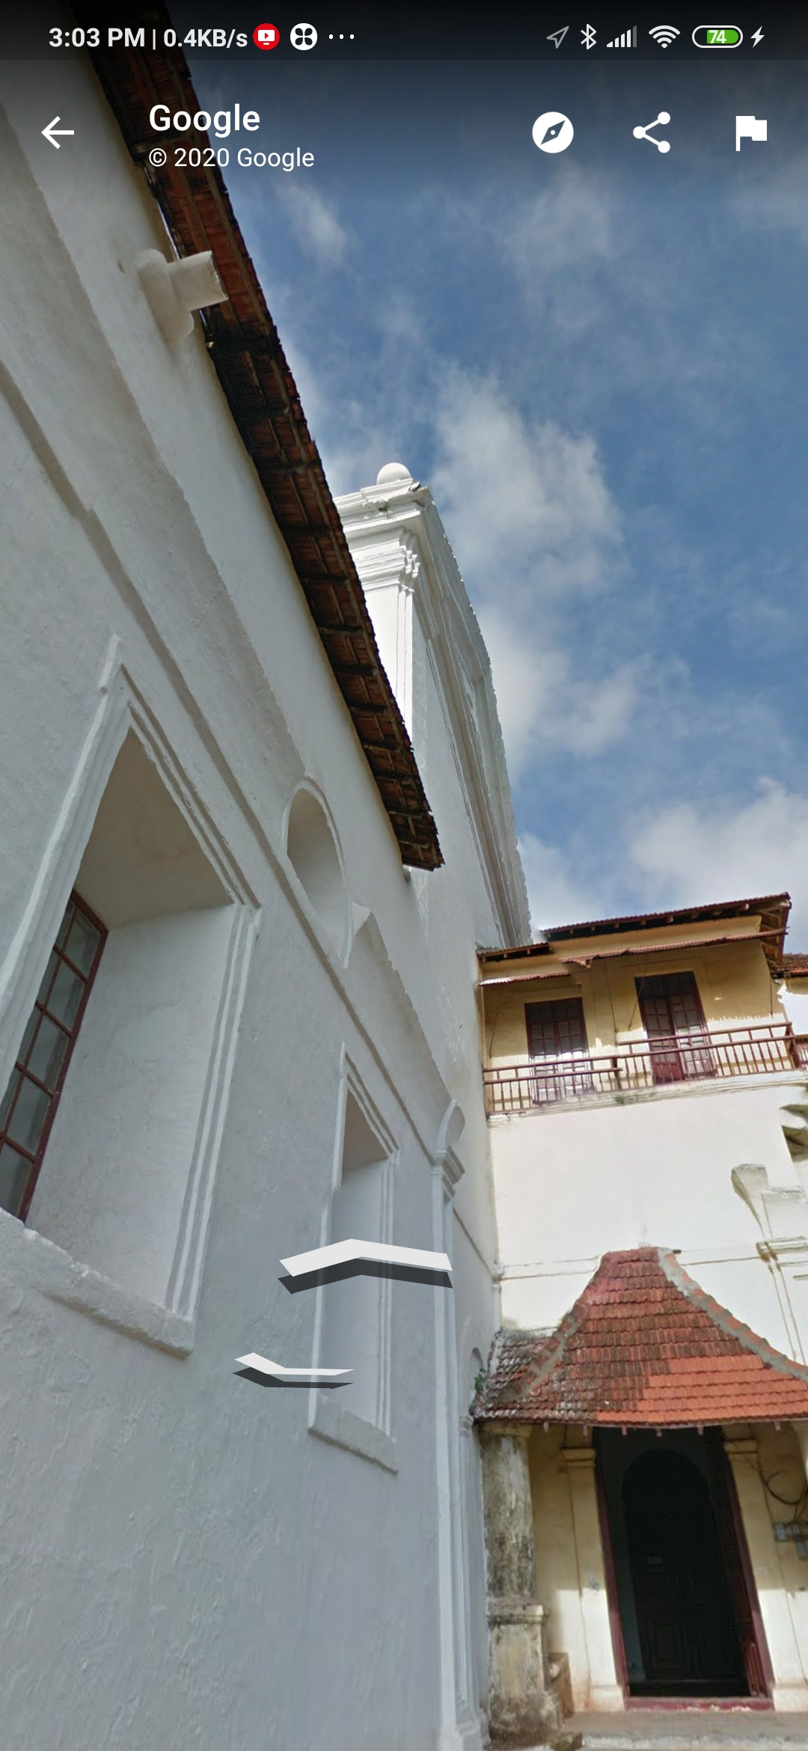

Slide 13
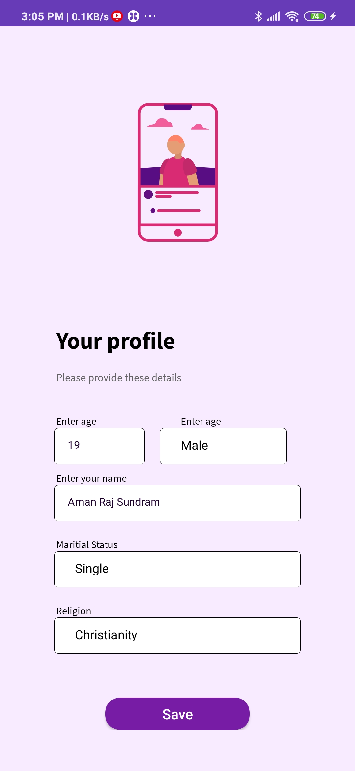
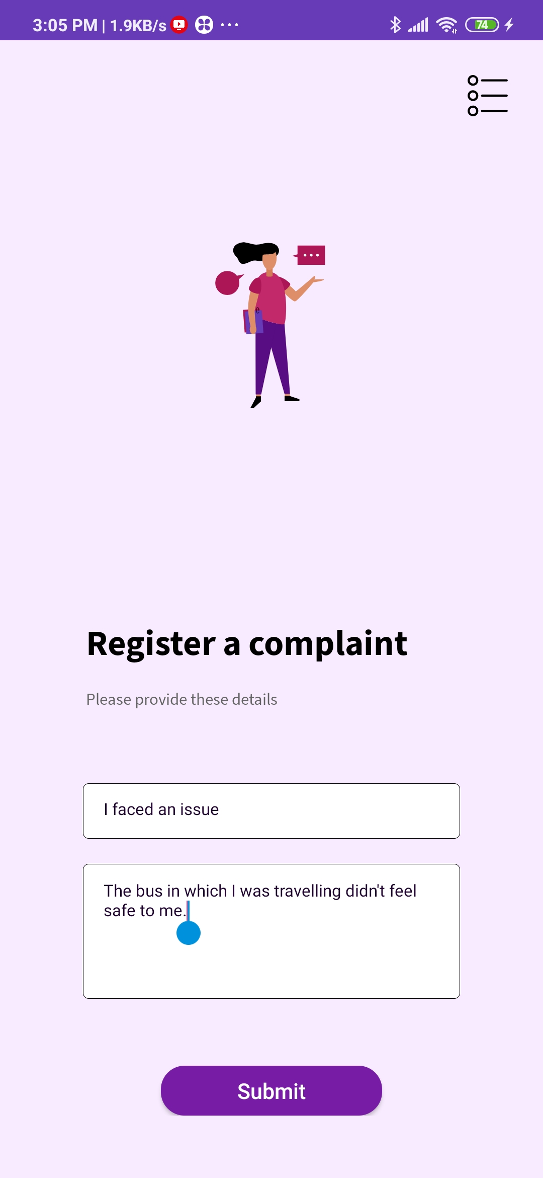
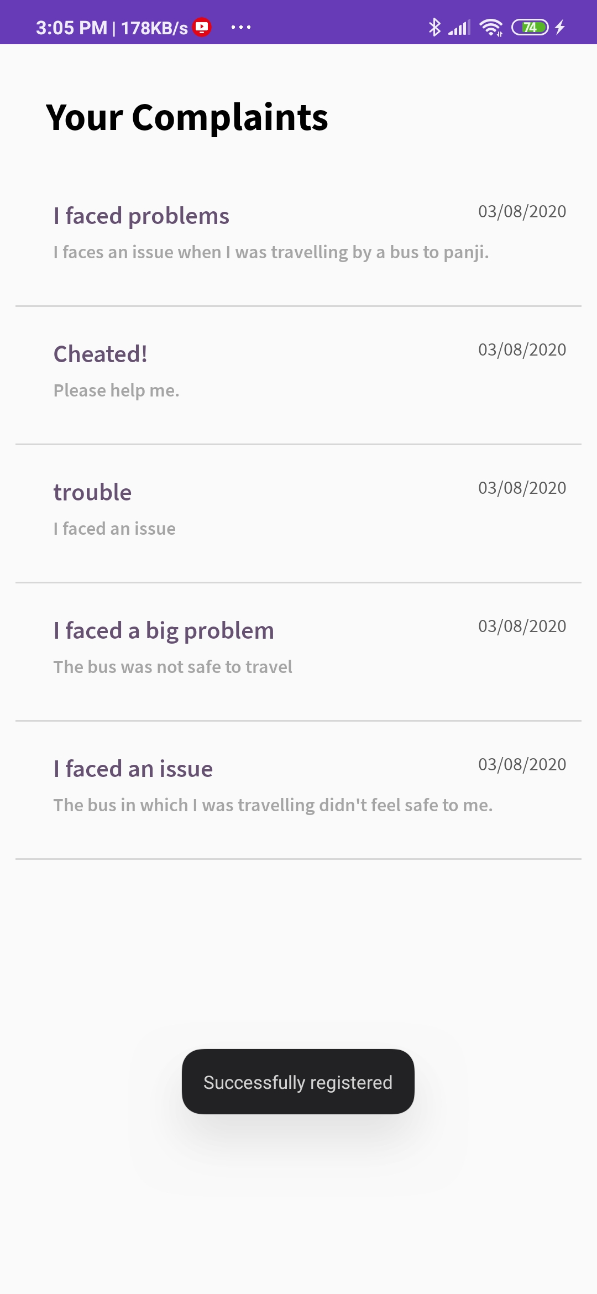
*Your Profile determines your home screen view
*Register Your Complaint
*View your Complains

Slide 14
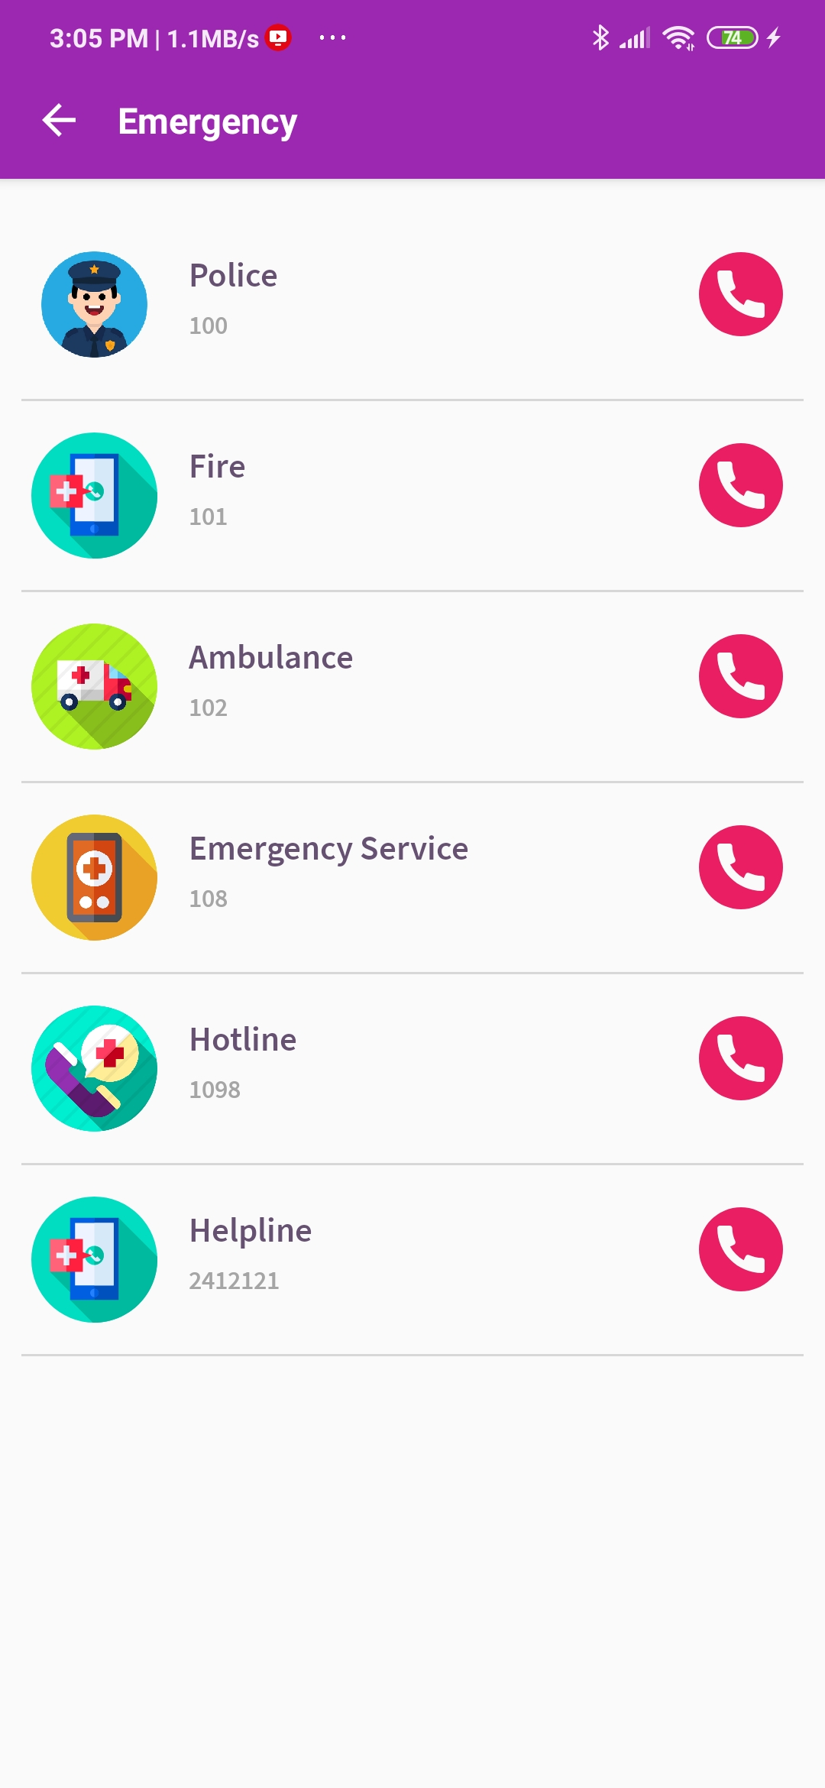
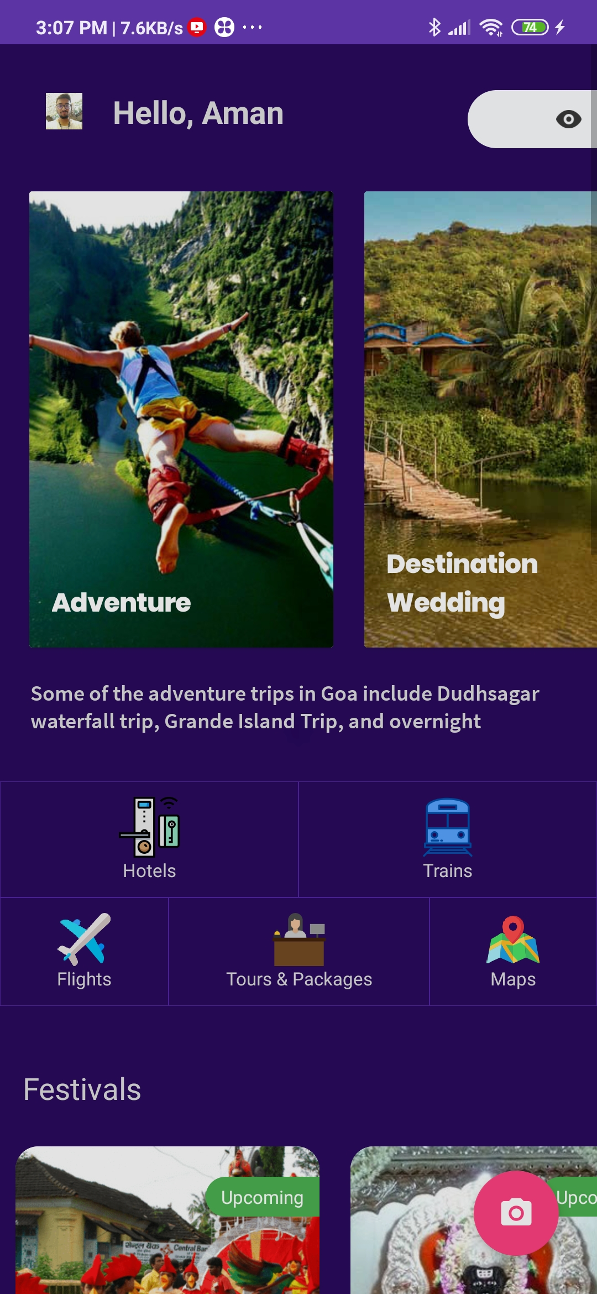
*Emergency Services because security is of prime importance
*Of course the Dark Mode to sooth your eyes!

Slide 15
Thank You ☺

